Slide 1


The Effect of “Above and Beyond” Descriptions of Amenities on Airbnb Ratings
Notes:
Ask a question:

Slide 2
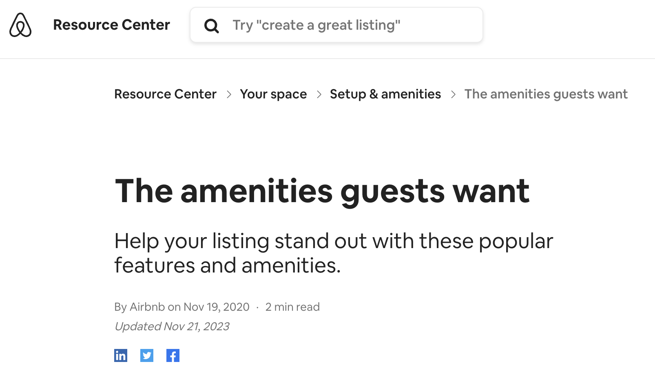

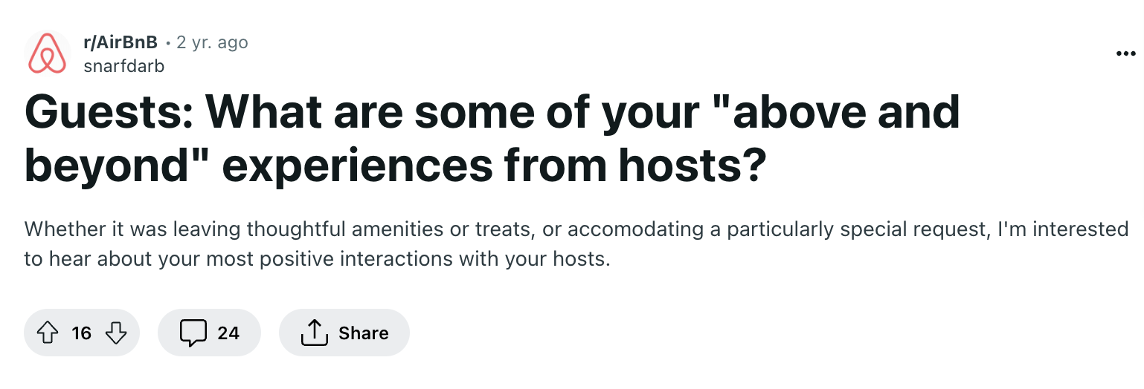
What is “Above and Beyond” ?
Notes:
Does that actually increase their rating? Or would it set a higher expectation for customers and end up hurting the rating when they fail to meet the expectations?
https://community.withairbnb.com/t5/Support-with-your-bookings/Going-above-and-beyond-for-guests/m-p/608570
https://www.airbnb.com/resources/hosting-homes/a/the-amenities-guests-want-25

Slide 3
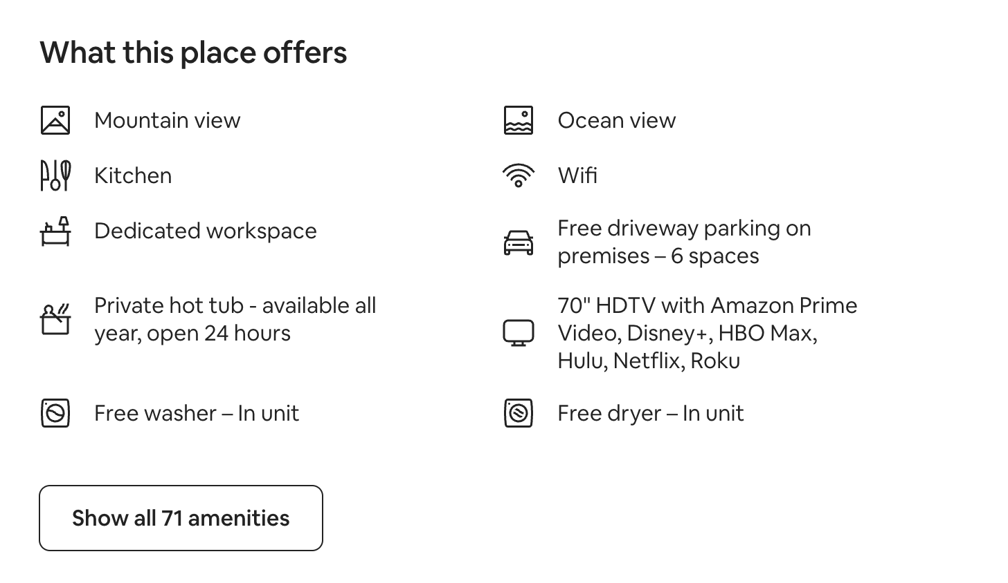
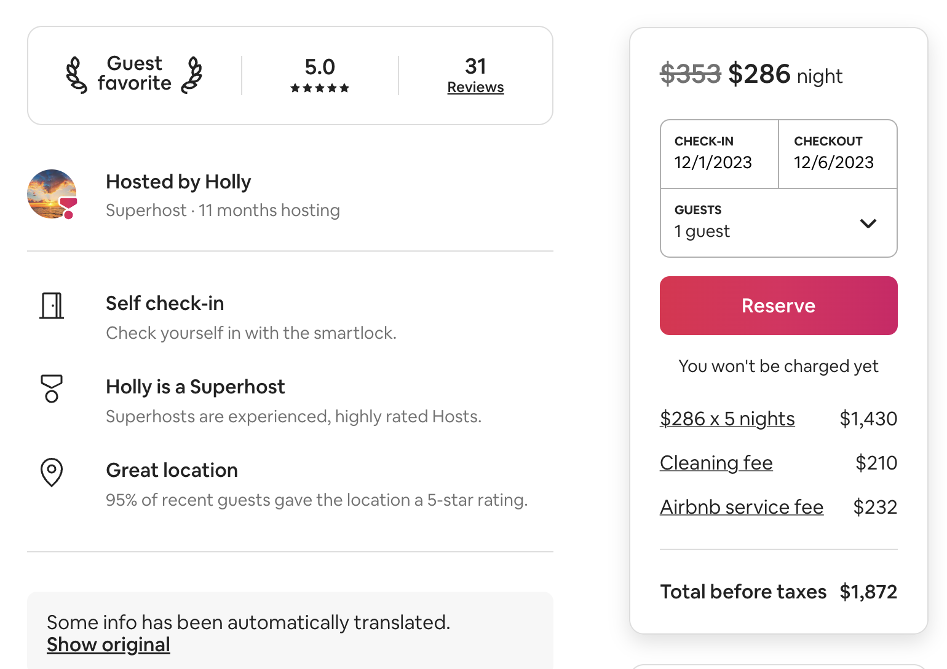
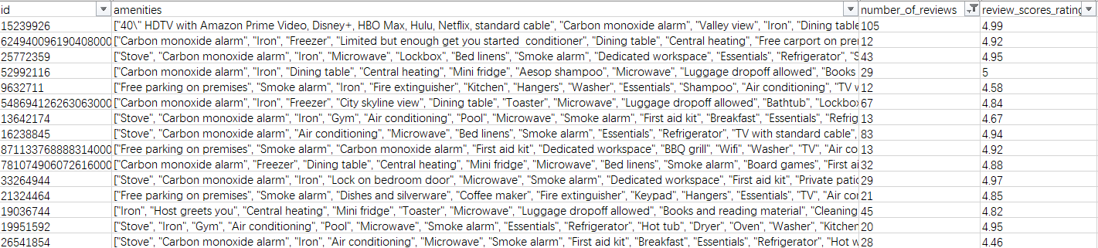
How Are Hosts Describing Their Amenities?
Notes:
We started looking at different airbnb posts online and our dataset, and we found that airbnb hosts can personalize their amenities: they can pick and choose how many amenities they want and customize their owns. We then believe ‘Amenities’ is a way for the hosts to be “above and beyond” and stand out from the crowd with their own descriptions

Slide 4
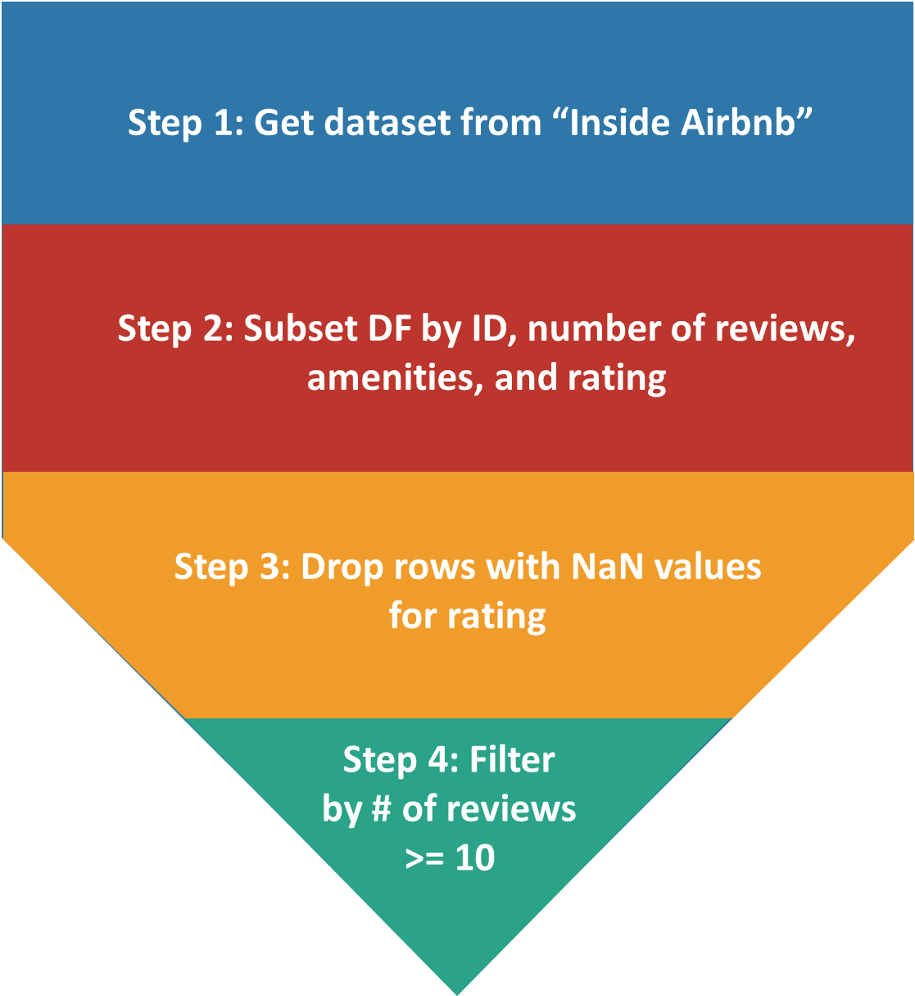
Data Cleaning process
Data Source:
http://insideairbnb.com/get-the-data
~44600 observations with 74 variables
~44600 observations with 4 variables
~33000 observations with 4 variables
~19000 observations with 4 variables
Notes:
Now, let’s talk about the approach we took to this problem. First, the data cleaning process.
Need # of review histogram/ reasoning of why we chose to filter the dataset by at least 10 reviews
Causing a hindrance to the observations so to make the dataset a little bit cleaner and more prceise

Slide 5
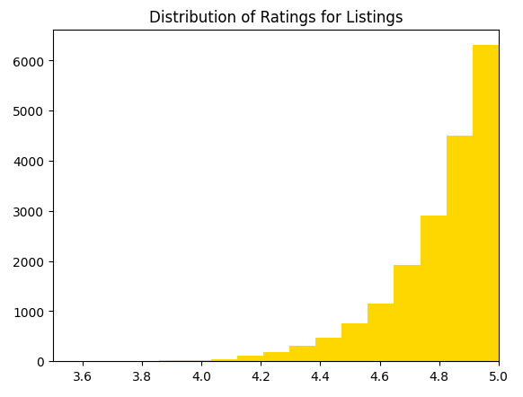
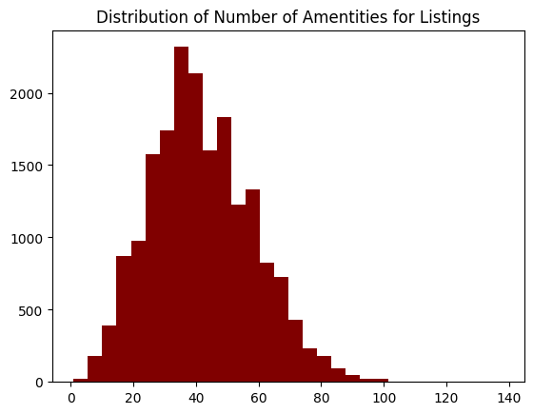
Preliminary Analysis
The correlation coefficient between number of amenities and rating is 0.268
Notes:
Once we have our dataset, we first look into the # of amenities. From the histograms and correlation matrix, we learned that there is a 0.268 correlation coefficient between the number of amenities and the rating. We also found that the mean of rating and the mean of # of amenities are about 4.9/5 and 40+ amenities. However, after discussed with our team and also reviewed the feedbacks from the other groups, we believe the number of amenities doesn’t really reflect “above and beyond” airbnb hosts and decided to move on to study the type of amenities.

Slide 6


Technical Breakdown of Methodology - Pt. 1
Basic Descriptions of Amenities:
Control Group(n = 500)
“Above and Beyond” Descriptions:
Experimental Group(n = 500)
“42\" TV with Netflix”
“48\" HDTV”
“43\" HDTV with Fire TV”
“65\" TV with Roku”
“50\" TV with standard cable”
“32\" TV with Amazon Prime Video”
“TV”
“Wifi”
“Fast Wifi”
“Fast wifi \u2013 474 Mbps”
“Fast wifi \u2013 215 Mbps”
Notes:
So when we look back to the amenities column in the dataset, which is a list of list containing every amenities on each airbnb host listing. we chose the focus on the “TV” and “Wifi” amenities to identify those “above and beyond” airbnb hosts, . The reason behind this is because we believe these two amenities are the most popular. Almost all hosts would have TV and Wifi in their place. Also, we believe the hosts who are willing to provide extra information and adding adjective to their amenities are the “Above and Beyond” airbnb host. Here are some samples of our experimental group, who has the “Above and beyond” descriptions. On the left, which is our control group who is using the default “TV” and “Wifi” amenities. And on the right, is our experimental group who is adding extra information to their amenities.

Slide 7
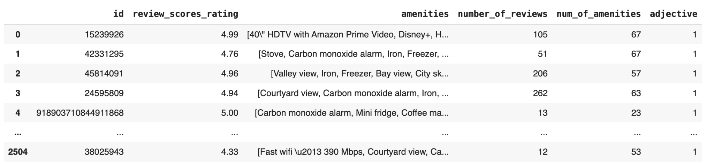
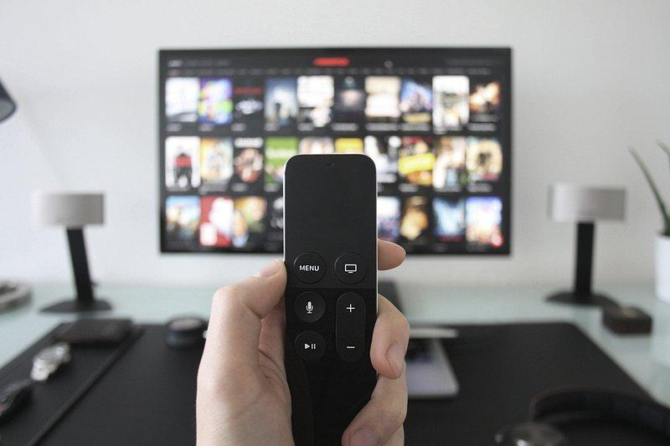

Technical Breakdown of Methodology - Pt. 2
Combine the control(500) and experimental groups(500) as our final sample dataset
Notes:
Once we know how to locate our “above and beyond” host, we start working on the coding part. Here is a example of our experimental group. We ran a for loop in the Amenities column. Whoever has the “above and beyond” description would be considered as True in our “Adjective” dummy variable. For our final sample dataset for regression, we have randomly select 500 samples from both our control and our experimental group and combine into our final sample dataset.

Slide 8
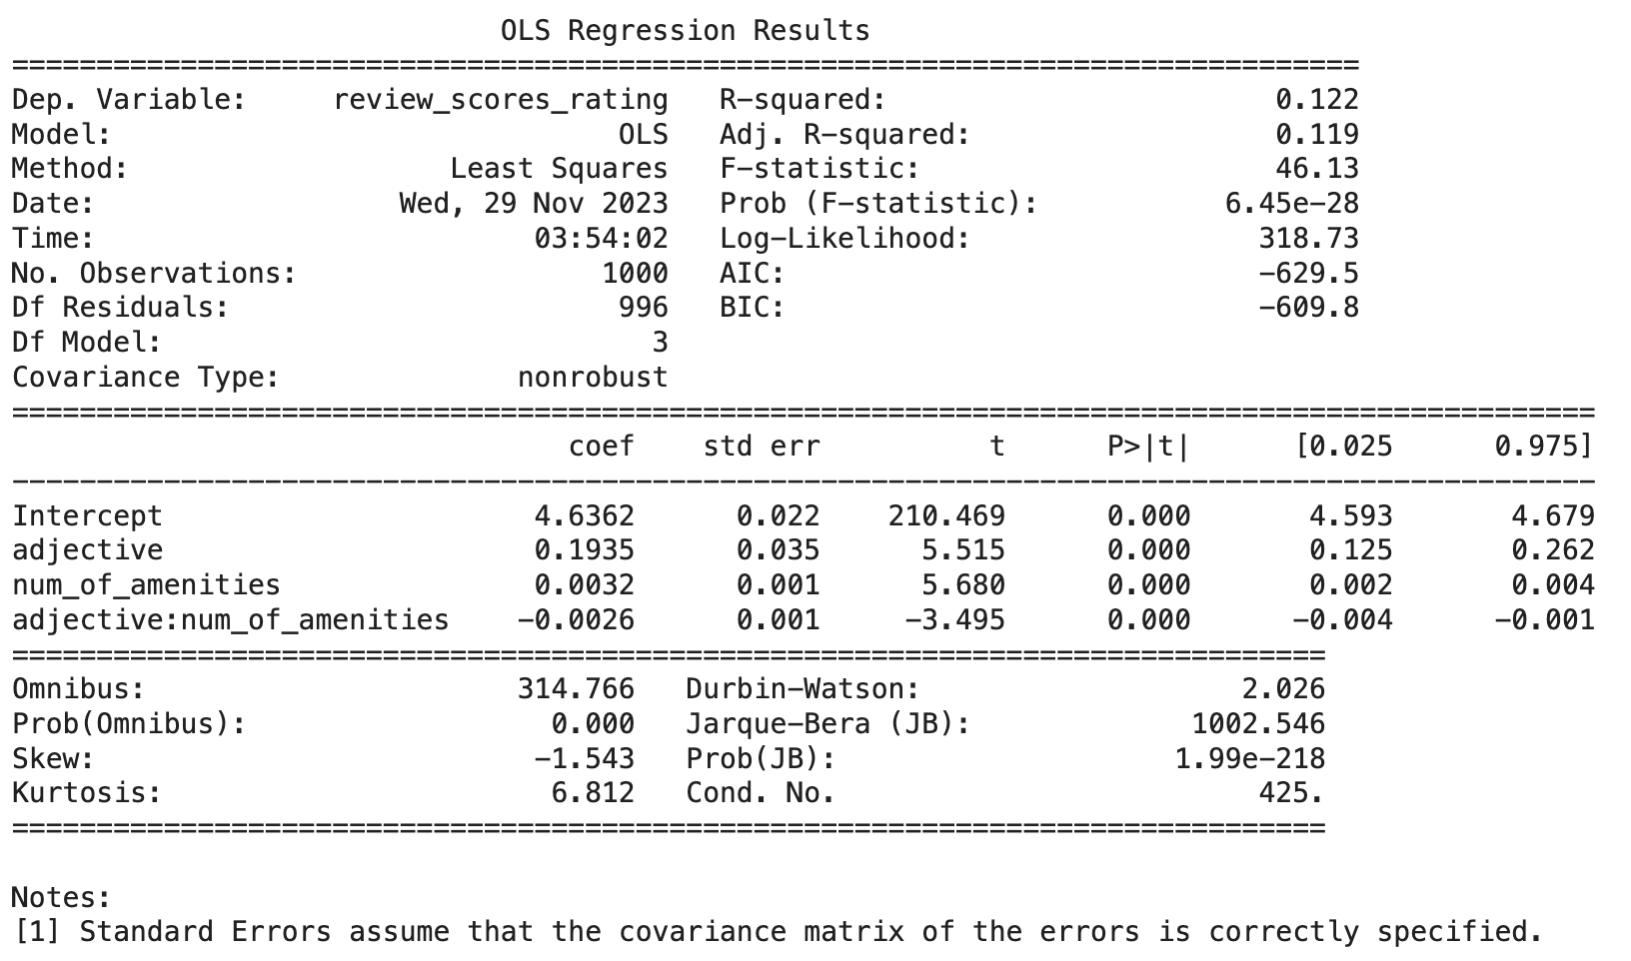
Regression Model Result
Final Regression Model:
Rating = 4.64 + 0.19(Adjective) + 0.0032(# of Amenities) - 0.0026(Adjective * # of Amenities)
Notes:
In our final regression model, we decided to include our dummy variable - Adjective, # of amenities, and the interacting variable to maximize the adjusted R-squared. So you can see: the intercept of rating is 4.64 and the slope of our variables are respectively 0.19, 0.0032, and -0.0026.
As we know the slope of the # of amenities and the interaction term is relatively small, which means that there is a small effect on rating.
But what’s more interesting to us is that for the same amount of # of amenities, the host who have the “above and beyond” description in their amenities would have about (0.19 - 0.0026 * the interaction term) higher rating than those who doesn have.
Next, alex would cover about our result of the hypothesis testing

Slide 9
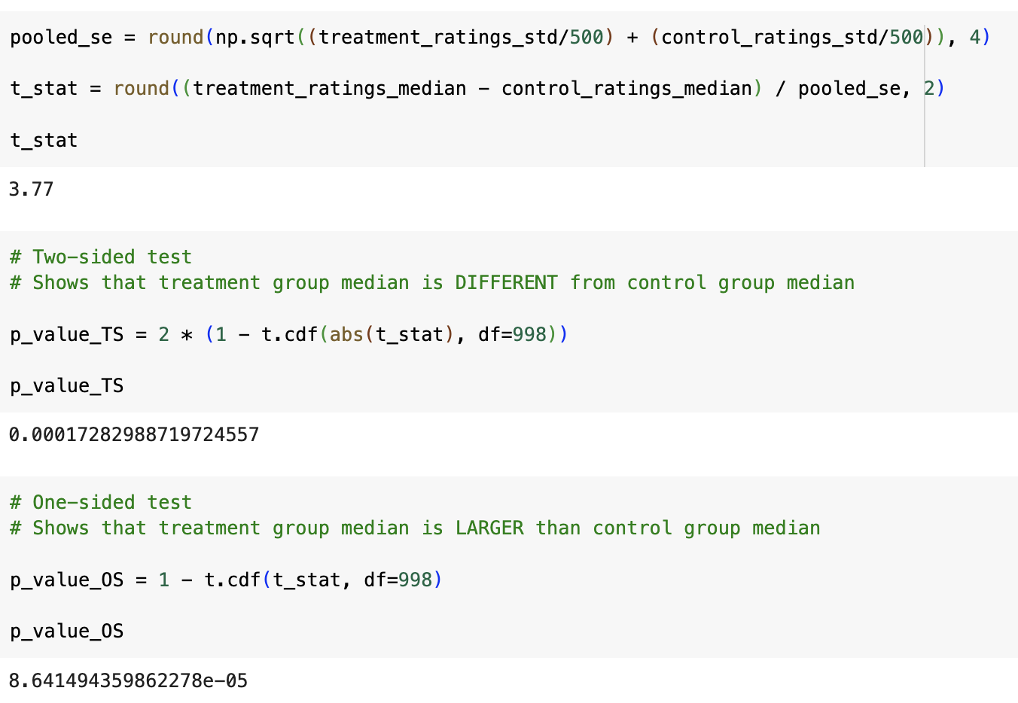
Two Sample Hypothesis Test Result
Null:
Hosts who go above and beyond actually don’t have higher ratings on a population level
Alternative:
Hosts who go above and beyond have different ratings than regular hosts on a population level
Notes:
We used median instead of mean because of the nature of rating skewness.

Slide 10
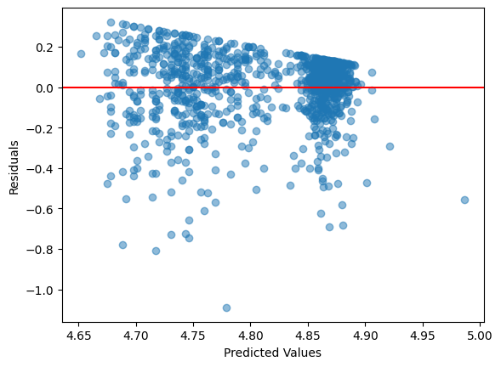
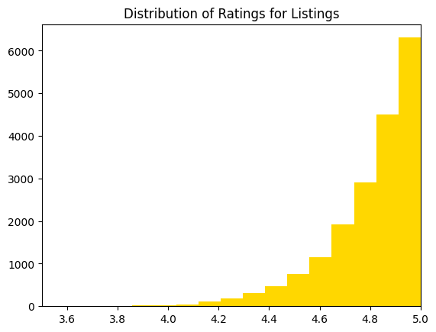
Limitations
Skewness of the data: Extremely left skew data indicating a trend of giving high rating toward 5 stars
Heteroscedasticity: The residuals are clustered and fan out as predicted value increases
Non-linearity: The pattern of residuals may suggest the relationships are non-linear
Overestimating: Most of errors are below zero, suggesting our predictions may be higher than actual values.
Goodness of Fit: Adjusted R-Squared is 0.119

Slide 11



Thank you !

Slide 12
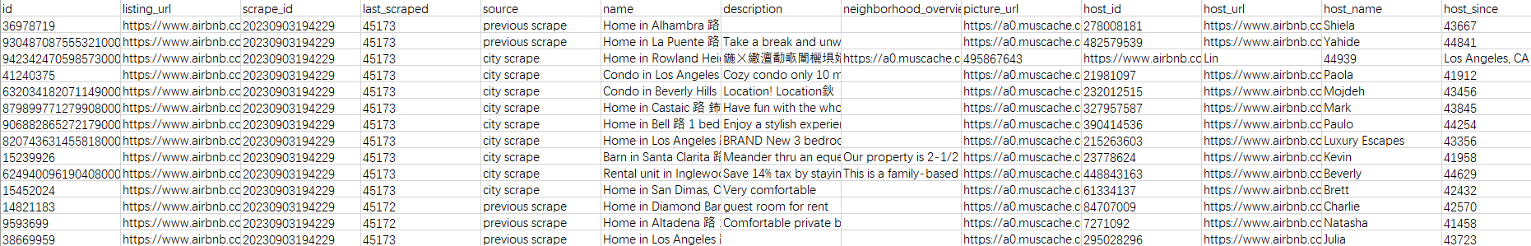
Data Cleaning process
Data Source: http://insideairbnb.com/get-the-data
Step 1: Get dataset from “Inside Airbnb”
~44600 observations with 74 variables
~44600 observations with 74 variables
Step 2: Subsetted DF by ID, number of reviews, amenities, and rating
~44600 observations with 4 variables
Step 3: Drop rows with NaN values for rating
~33000 observations with 4 variables
Subsetted DF by “ID”, “# of reviews”, “Amenities”, “Rating”
Drop Nan Values for rating
Filtered by # of reviews >= 10
Step 4: Filter by # of reviews >= 10
~19000 observations with 4 variables
Notes:
Now, let’s talk about the approach we took to this problem. First, the data cleaning process.
Need # of review histogram/ reasoning of why we chose to filter the dataset by at least 10 reviews
Causing a hindrance to the observations so to make the dataset a little bit cleaner and more prceise

Slide 13
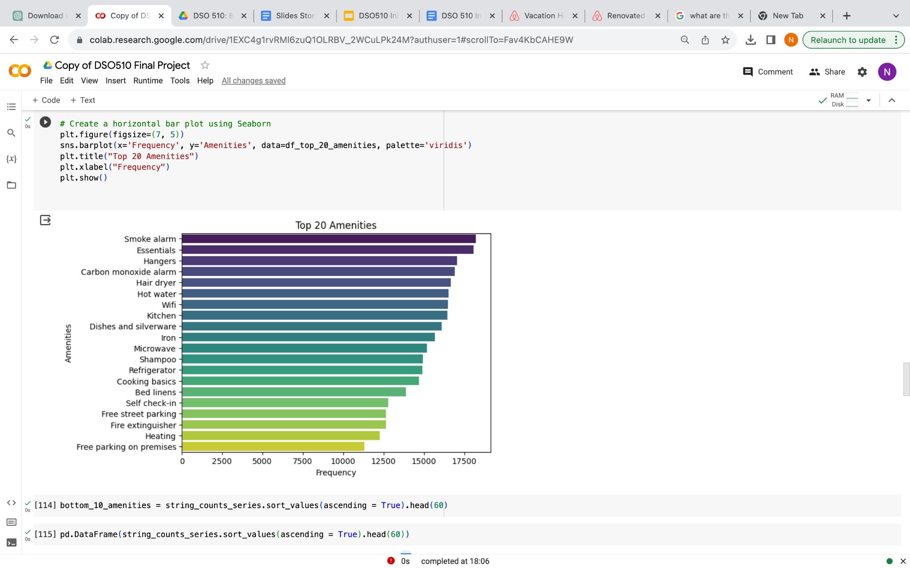
Preliminary Analysis - Xuanyu
Identifying 20 most common amenities in the listings:
Understanding the type of amenities that are most common across listings
Determining their relationship with ratings eg. identifying whether the unavailability of these common amenities have a considerable impact on ratings

Slide 14
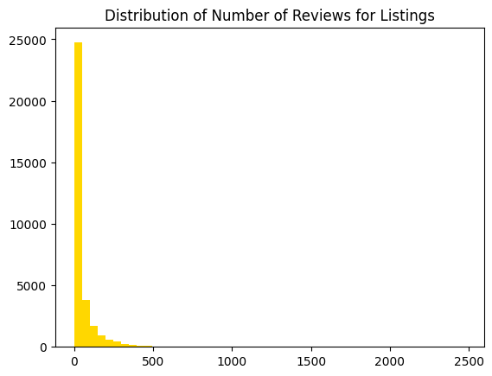
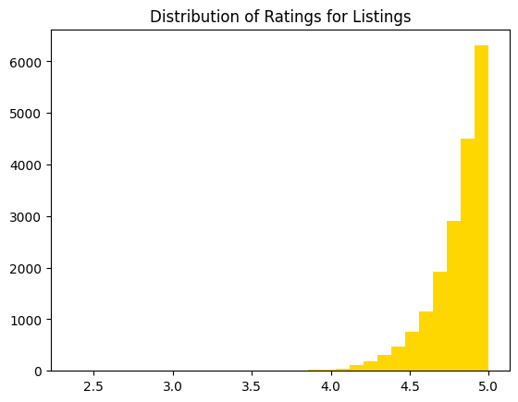
Preliminary Analysis - Xuanyu
Created a histogram based on the number of reviews for each listing
Added a column for the number of amenities per listing to create a histogram based on the number of amenities
Created a histogram based on the ratings from 0-5 stars
The correlation coefficient between number of amenities and rating is 0.268
Notes:
Correlation between # of amenities and rating

Slide 15



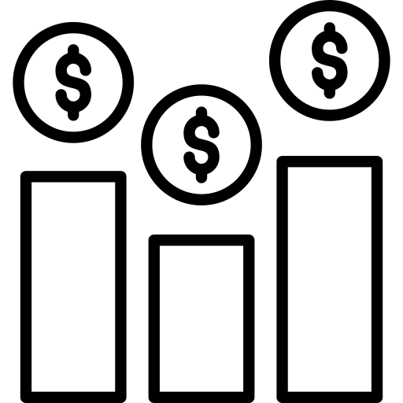


Airbnb - Abby
Online marketplace for short- and long-term homestays and experiences
We are interested in Airbnb because investors make decisions on…
We chose Los Angeles as our market because…
Visitor spending reached 89% and visitor volumes registered 91% of pre-pandemic levels, respectively (LA Tourism and Convention Board, 2023)
Whether or not to invest in a market according to seasonality and potential revenues (occupancy rates, average daily rates)
Daily rates have spiked over the past 4 years, with $152 in 2019 (pre-COVID) and $244 in 2023
How to perform against the competition based on pricing and reviews
One of the host cities for two mega events, 2028 Olympics and 2026 FIFA World Cup, signifying a long term growth for demand in accomodation
How to choose the right type of amenities to improve ratings and increase
Notes:
Airbnb market data analysis can help you make an informed decision about whether or not to invest in a market, convert your Airbnb and give you insights about how you perform against the competition. Dive into the top listings and view occupancy rates, daily rates, amenities and check out the full Airbnb listing.
https://www.latimes.com/business/story/2023-05-04/la-fi-tourism-mostly-back-except-biggest-spenders
Average Airbnb occupancy of 78% for an entire home

Slide 16
Ideal Experiment
1. Data Collection: Collect data on Airbnb listings using the existing datasets, including details such as price, host response time, amenities, and review scores rating.
2. Sample Selection: From the collected data, randomly select a certain number of Airbnb listings to ensure that the sample is representative.
3. Grouping: Divide the sample into different groups, with each group representing a specific type of amenity.
4. Control Variables: Ensure that other variables that could potentially affect ratings are controlled for in the analysis.
5. Data Analysis: Conduct statistical analysis of the ratings for Airbnb listings in each group.
6. Hypothesis Testing: Use statistical methods to perform hypothesis testing to determine if there are significant rating differences.

Slide 17
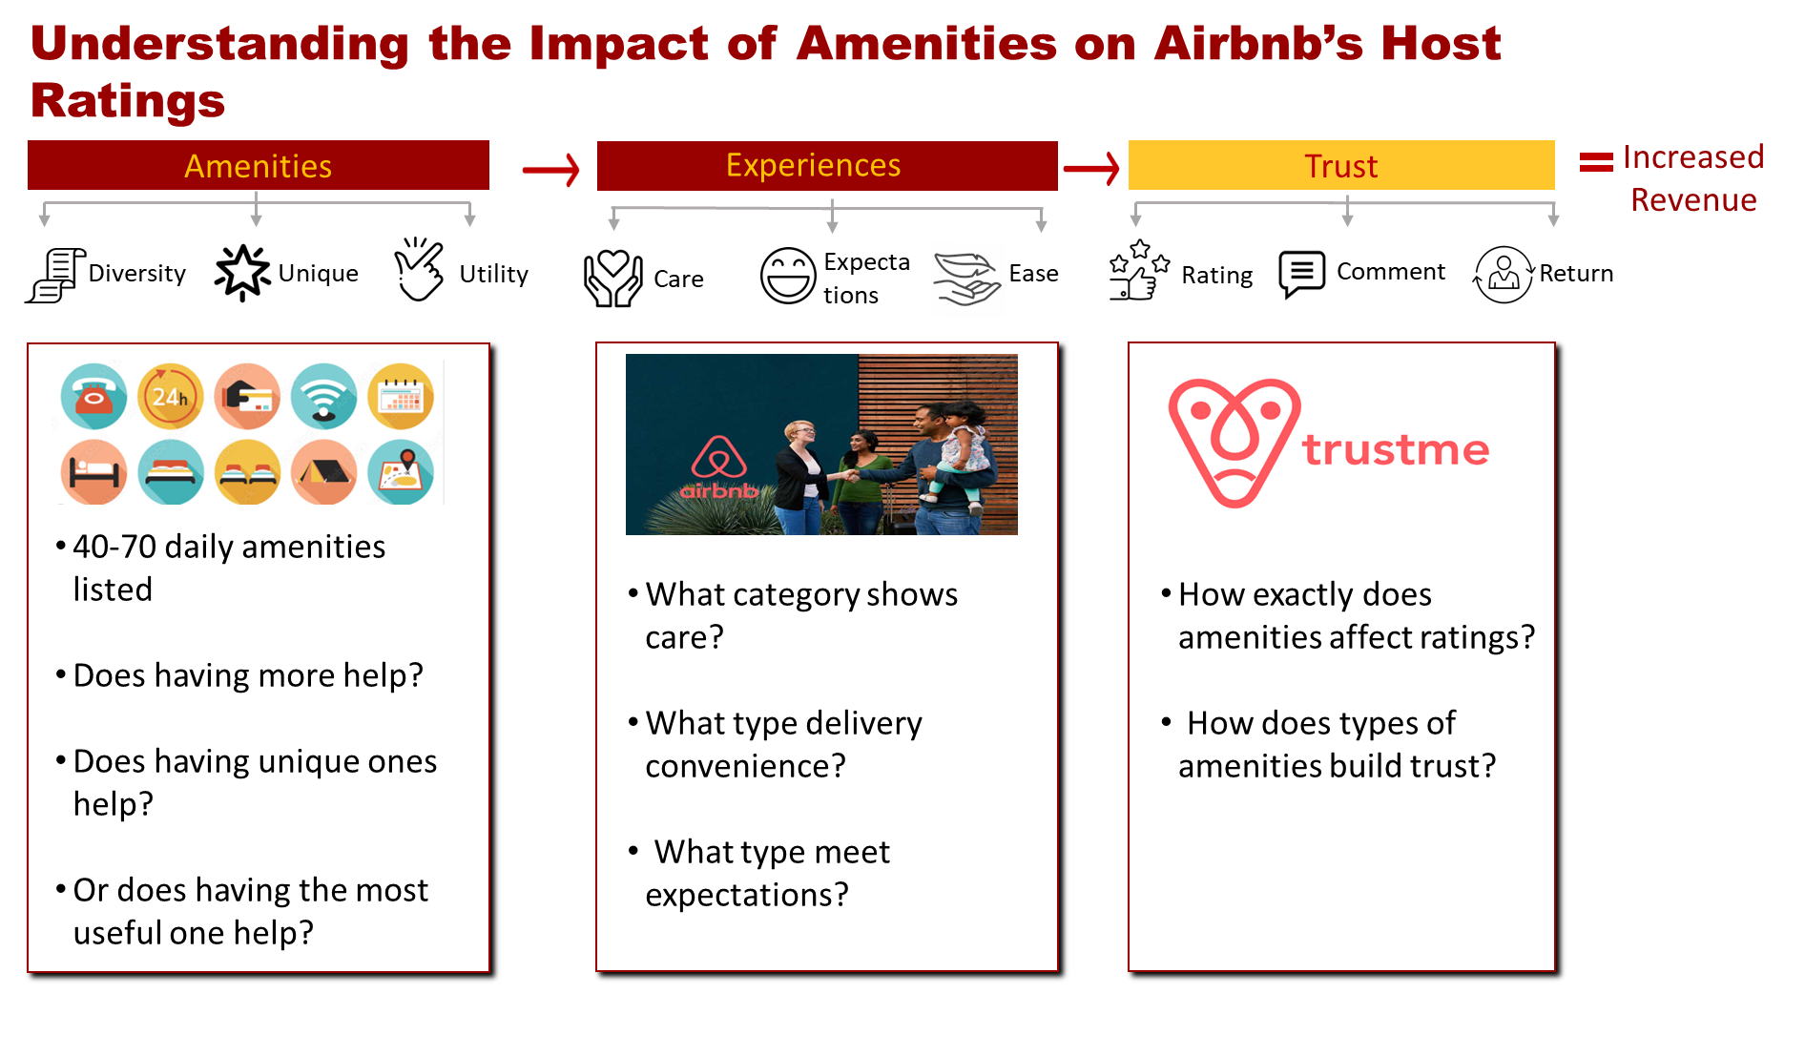
Notes:
Airbnb relies heavily on the trust between hosts and guests, which is significantly influenced by host ratings.
Amenities also play a crucial role in enhancing guest experience.
In this analysis, we delve into Airbnb's listing data to uncover the relationship between host ratings and the amenities provided.
Specifically, we aim to identify outstanding trends from the 40-70 daily amenities that we normally take for granted everyday, and users’ explicit perspective (ratings) towards having the least 10/top10 popular amenities, do having more actually help? Or does having some unique ones help? Let’s find out.

Slide 18
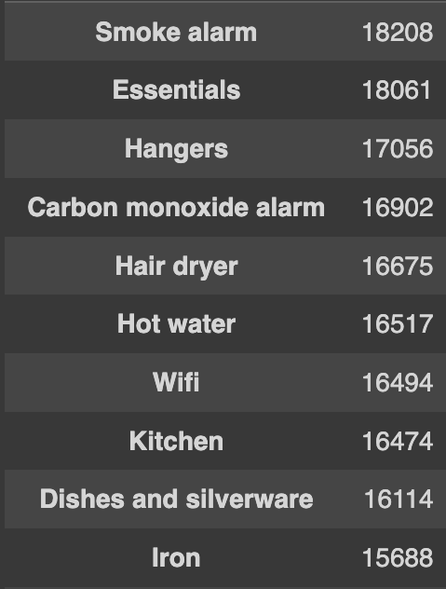
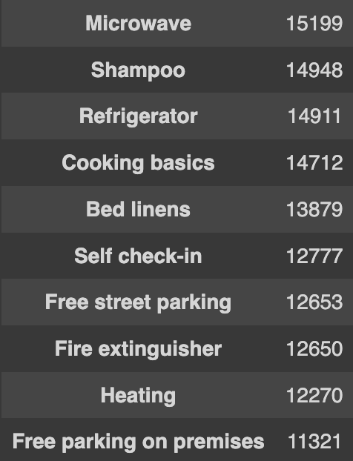
Preliminary Analysis Pt. 2
We found the top 20 most common amenities across all listings
Some belong to the same category (free parking on premises vs free street parking)
Use most common/unique amenities to determine if amenity type affects rating
Notes:
Correlation between # of amenities and rating

